Slide 1
The mathematics of running in the rain An exercise in modelling…
12/11/2016

Slide 2
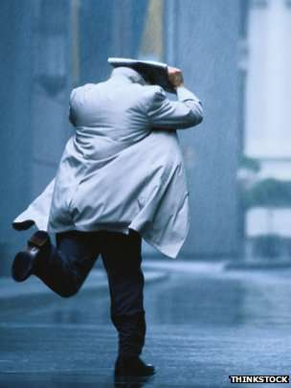
Going outside on a rainy day means, for most people, carrying an umbrella.
But if you happen to be a mathematician it’s a perfect chance to show off your modelling skills.
And for a mathematician in a classroom it’s a splendid opportunity to make it an exercise in modelling!

Slide 3
Content
Outline of the problem
Assignments
Mathematical model
Other models

Slide 4
1. Outline of the problem
which method keeps you the driest?
walking slowly? running as fast as possible?
optimal speed?
angle of your body?
hypothesis?
model?

Slide 5
1. Outline of the problem
idealization: rectangular shaped body

Slide 6
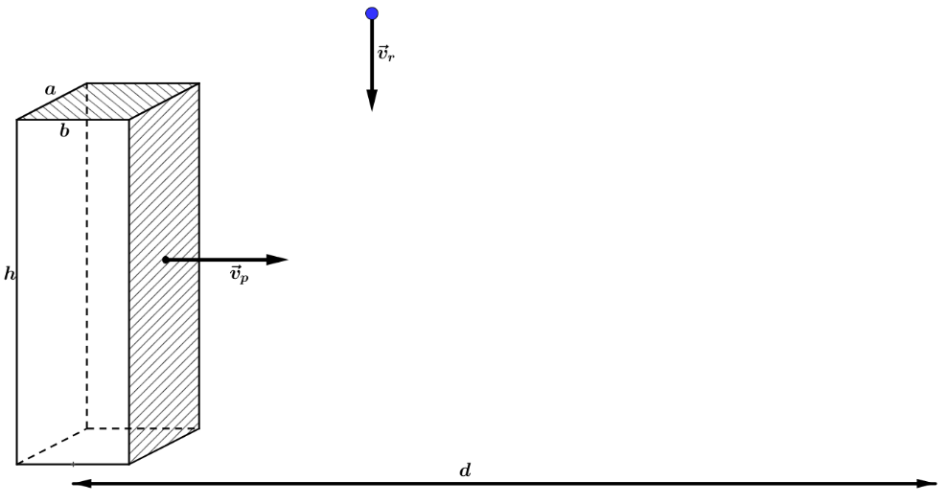
1. Outline of the problem
rain is falling straight down
distance $d$ from shelter

Slide 7
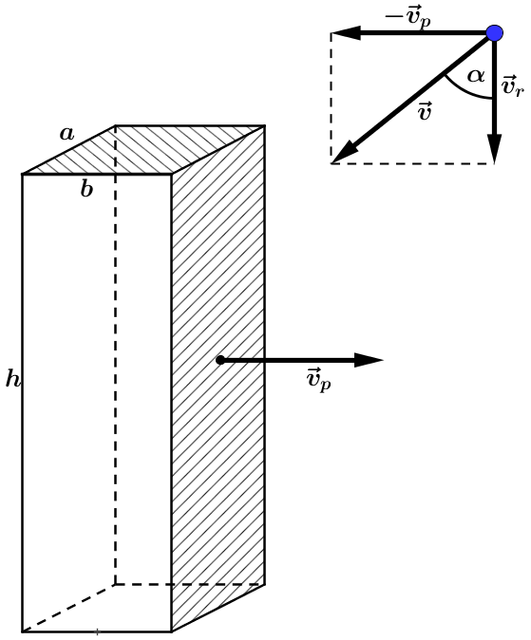
1. Outline of the problem
$$\vec{v}=−{\vec{v}}_{p}+{\vec{v}}_{r}$$

Slide 8
2. Assignments
create a simple mathematical model
lesson material developed for 16 year old students

Slide 9
3. Mathematical model
if $v_{p}→0$ m/s then $t=\frac{d}{v_{p}}→+∞$ and therefore $m→+∞$
$v_{p}=0,1c≈3⋅{10}^{7}$ m/s $⇒$ $t=\frac{d}{v_{p}}=3,3⋅{10}^{−6} s$
$=3,3 μs$
during this interval raindrops have been falling over a distance
$h=v_{r}⋅3,3⋅{10}^{−6} m=9,9⋅{10}^{−6} m$
$≈{10}^{−5} m=0,01 mm$
only the front of sponge Bob gets wet!

Slide 10
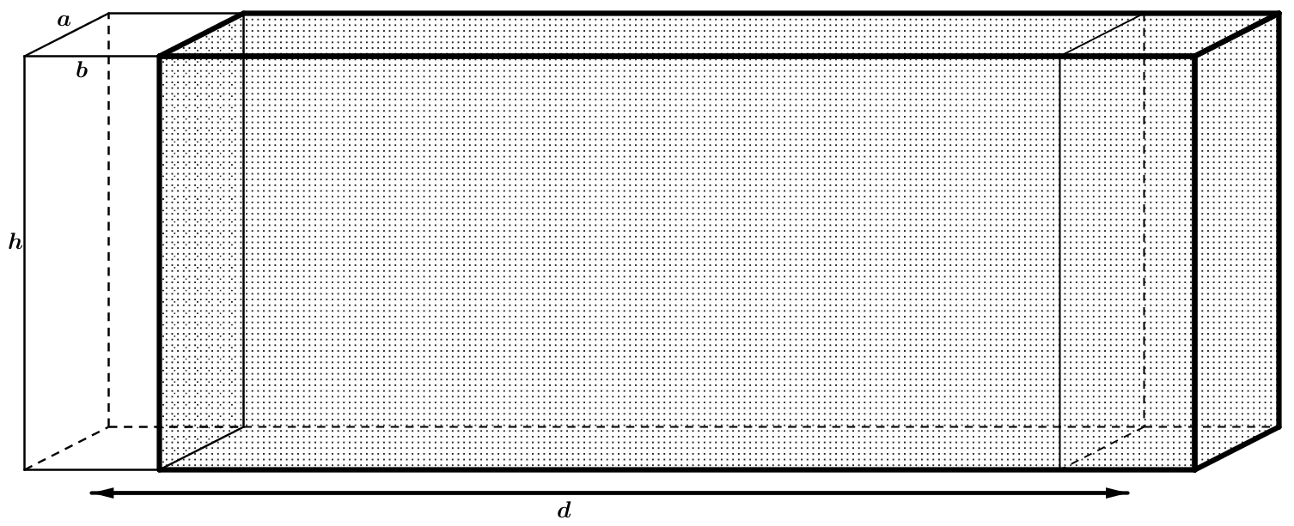
3. Mathematical model
only the front of sponge Bob gets wet!
the volume of water ‘swept’ by Bobs front: $V=adh$
$m=Vρ=ahdρ$

Slide 11
3. Mathematical model
$v=\sqrt{v_{p}^{2}+v_{r}^{2}}$
$tanα=\frac{v_{p}}{v_{r}}$
$Δt=\frac{d}{v_{p}}$
$m_{B}=y⋅\frac{d}{v_{p}}$
$y=z⋅ρ$
$m_{B}=z⋅ρ⋅\frac{d}{v_{p}}$

Slide 12
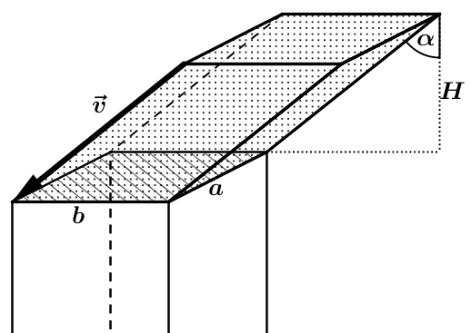
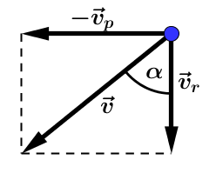
3. Mathematical model
$z=ab⋅H=ab⋅v_{r}$
$m_{B}=z⋅ρ⋅\frac{d}{v_{p}}=abv_{r}ρ\frac{d}{v_{p}}$

Slide 13
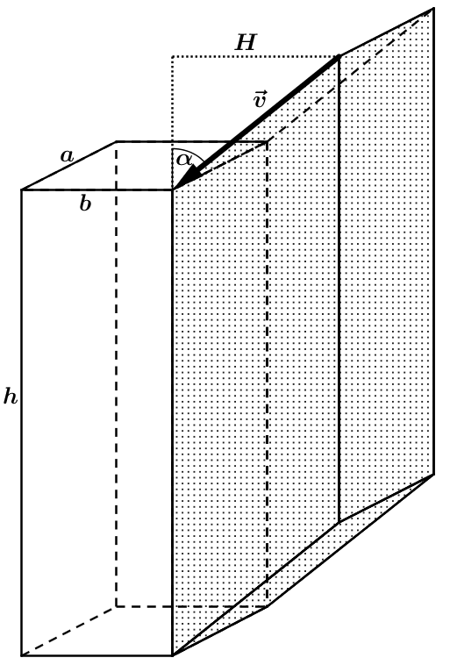
3. Mathematical model
$$m_{V}=V_{par.}⋅ρ\frac{d}{v_{p}}$$
$$=ahH⋅ρ\frac{d}{v_{p}}$$
$$=ahv_{p}⋅ρ\frac{d}{v_{p}}$$
$$=ahρd$$

Slide 14
3. Mathematical model
The volume of water, swept horizontally, is the volume of a cuboid. This volume equals the volume of the parallelepiped with the same height and bottom surface:
$V=ahd$ $⇒$ $m_{V}=ahdρ$

Slide 15
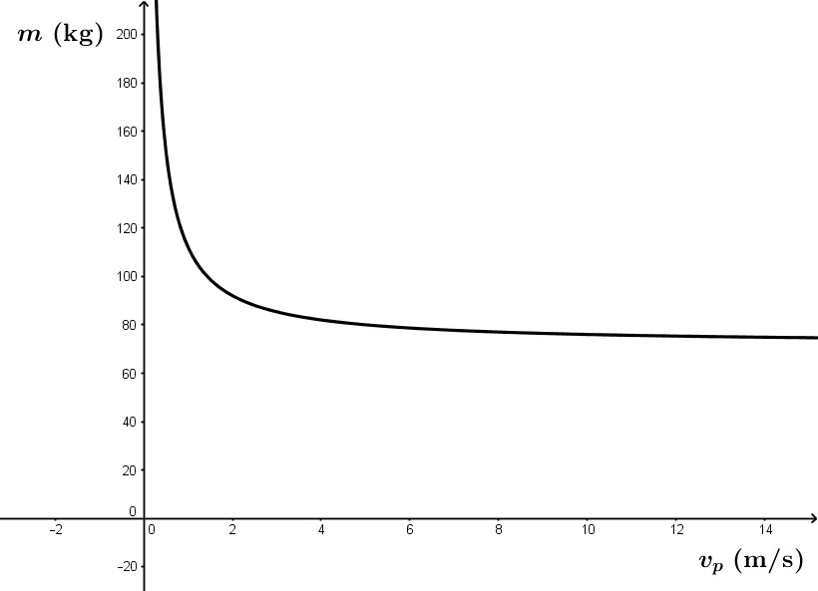
3. Mathematical model
$m=m_{B}+m_{V}$ $=abv_{r}ρ\frac{d}{v_{p}}+ahρd$ $$=adρ(b\frac{v_{r}}{v_{p}}+h)$$
$d=100 m$
$v_{r}=2$ m/s
$a=0,20$ m
$b=0,50$ m
$h=1,80$ m
$ρ=2$ kg/m³
conclusion: Bob has to run as fast as possible to get the least wet

Slide 16
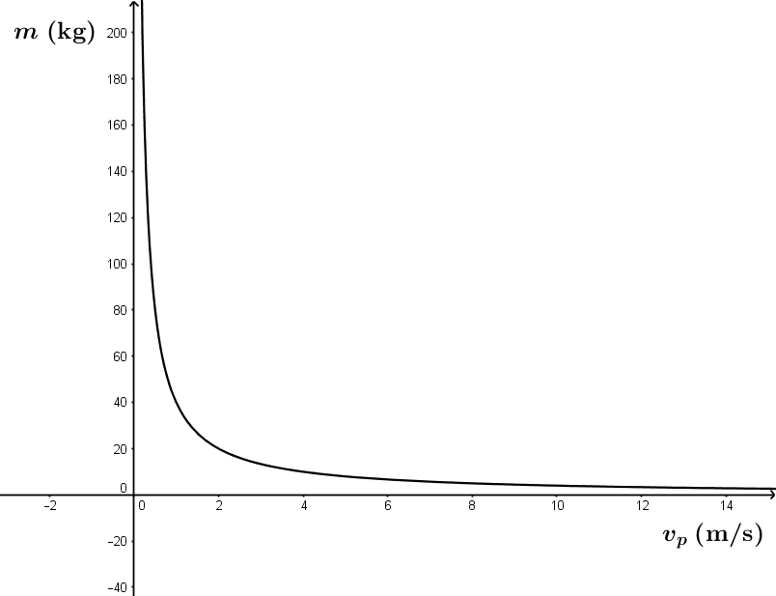
3. Mathematical model
if the angle of Bobs body equals $α$ he only catches raindrops with his head and shoulders and not with the front of his body
leaning forward helps him stay dry
$m_{V}=0$
$⇒m=abv_{r}ρ\frac{d}{v_{p}}$

Slide 17
3. Mathematical model
How?
Example:
- suppose Bob runs exactly at the speed of the rain, $v_{p}=v_{r}$, thus $α=45°$
$v_{p}=7,2$ km/h
- in that case: if the angle of his body is also $45°$ he catches the least amount of rain

Slide 18
4. Other models
1970s: first papers in mathematical magazines debating the question
1987: italian researcher states that changing strategies do not make a substantial difference
2003: mythbusters show that walking is a better option for staying dry
2005: mythbusters corrected for a false result: running fast is the best option

Slide 19
4. Other models
2009: article in mathematics magazine
http://demonstrations.wolfram.com/RunningInTheRain/
2011: a textile expert and a physicist suggest that an optimal speed exists

Slide 20
4. Other models
2012: Franco Bocci
complex situation: answer depends on an individual's height-to-breadth ratio as well as wind direction and raindrop size
‘If you're really thin, it's more probable that there will be an optimal speed. Otherwise, it's better to run fast.’
“As for wind direction - and again, in general - you should run as fast as you can unless the wind is behind you, in which case the optimal speed will be exactly the speed of the wind.”

Slide 21
4. Other models
minutephysics
movie
mythbusters
movie

Slide 22
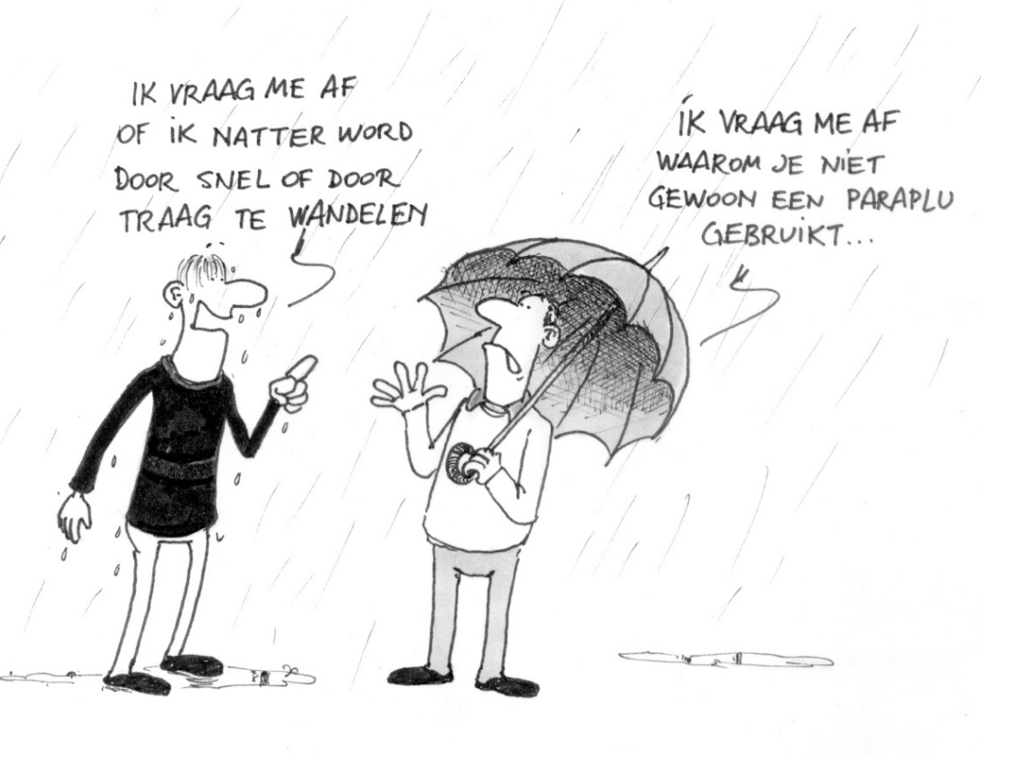
3. Mathematical model
I wonder if it matters whether I’m walking fast or slow
And I wonder why you just don’t use an umbrella…

